Slide 1
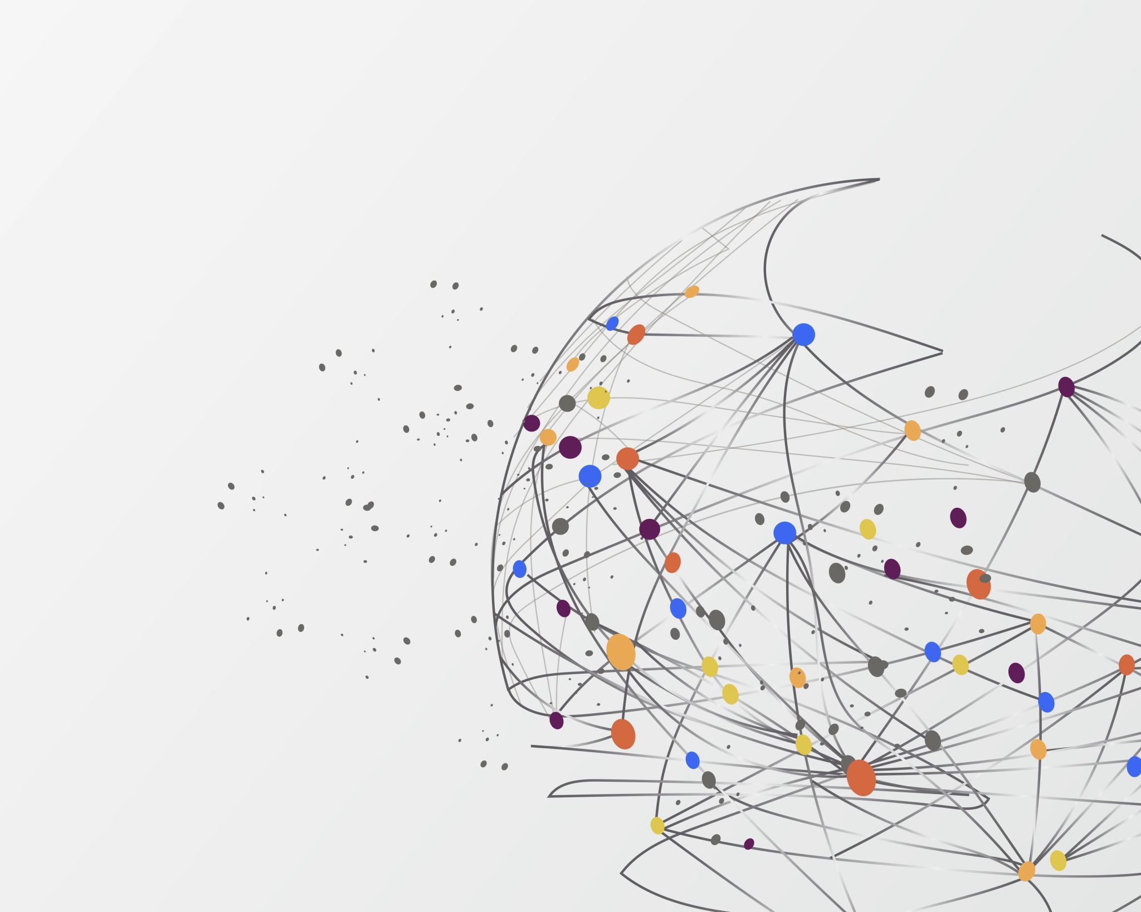
SMARTLAPREC – A LAPTOP RECOMMENDATION SYSTEM
Cpsc 583
SMARTLAPREC
A LAPTOP RECOMMENDATION SYSTEM
GUIDED BY:​
Prof. Anand Panangadan​
​
TEAM MEMBERS:​
Dhruti Dilipbhai Patel​
Pratishtha Soni​
Tushar Yadav​

Slide 2
Problem statement
overview
Our project focuses on developing an expert recommendation system for laptops using Semantic Web technologies. Leveraging RDF and OWL, the system represents laptop specifications, user preferences, and budget constraints. Through SPARQL queries and semantic reasoning, the system dynamically generates personalized recommendations, providing users with tailored suggestions based on their unique preferences and requirements.

Slide 3
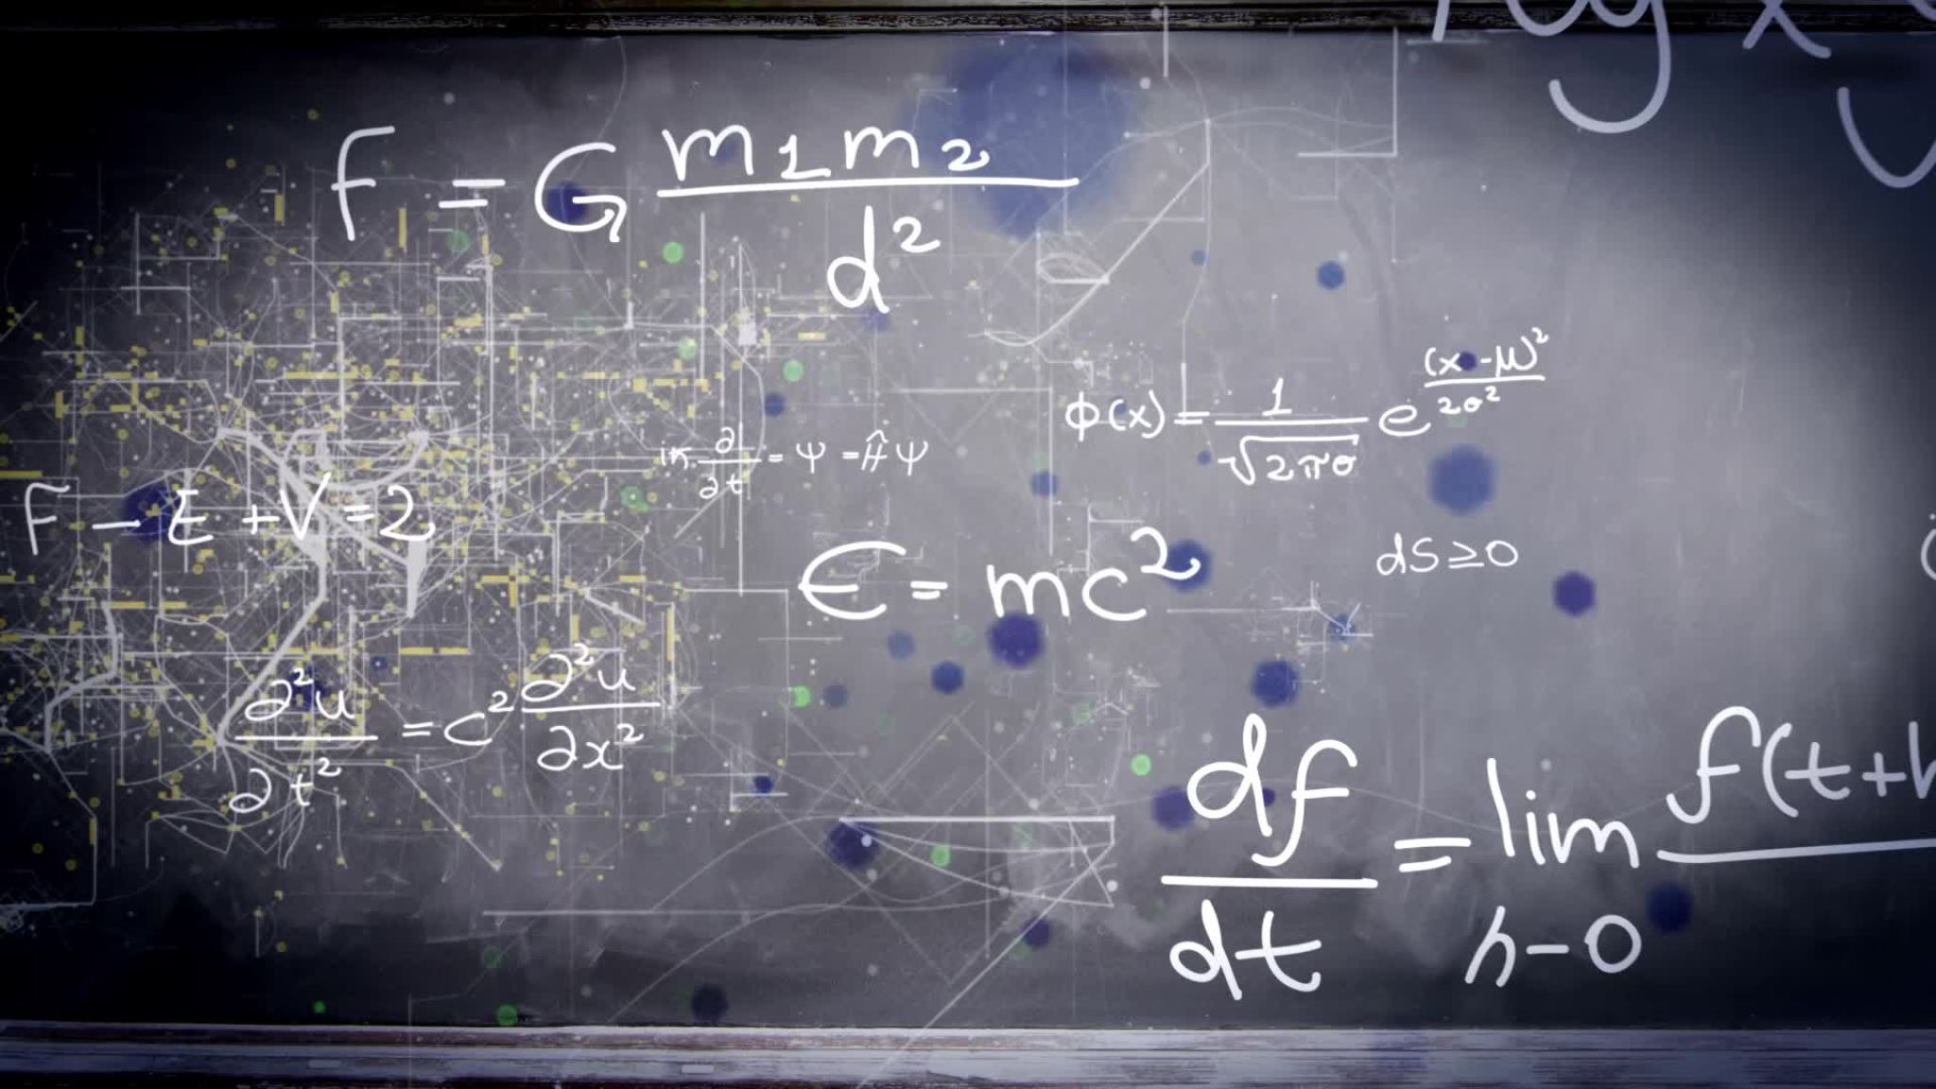
2. Solution approach

Slide 4
Semantic Web
Defining an ontology using RDF and OWL to represent laptop specifications, user preferences, and relationships within the domain.
Representing laptop data and user profiles in RDF format, incorporating instances of the defined ontology.
Adding Semantic reasoning by helping it understand more things about laptops and users. This way, it can figure out additional details and connections on its own, improving how it gives recommendations.
Implementing SPARQL queries to retrieve relevant information from the RDF data store, allowing the system to generate recommendations based on user-specified criteria.
Developing a user-friendly interface where users can input preferences and view personalized recommendations generated by the system.

Slide 5
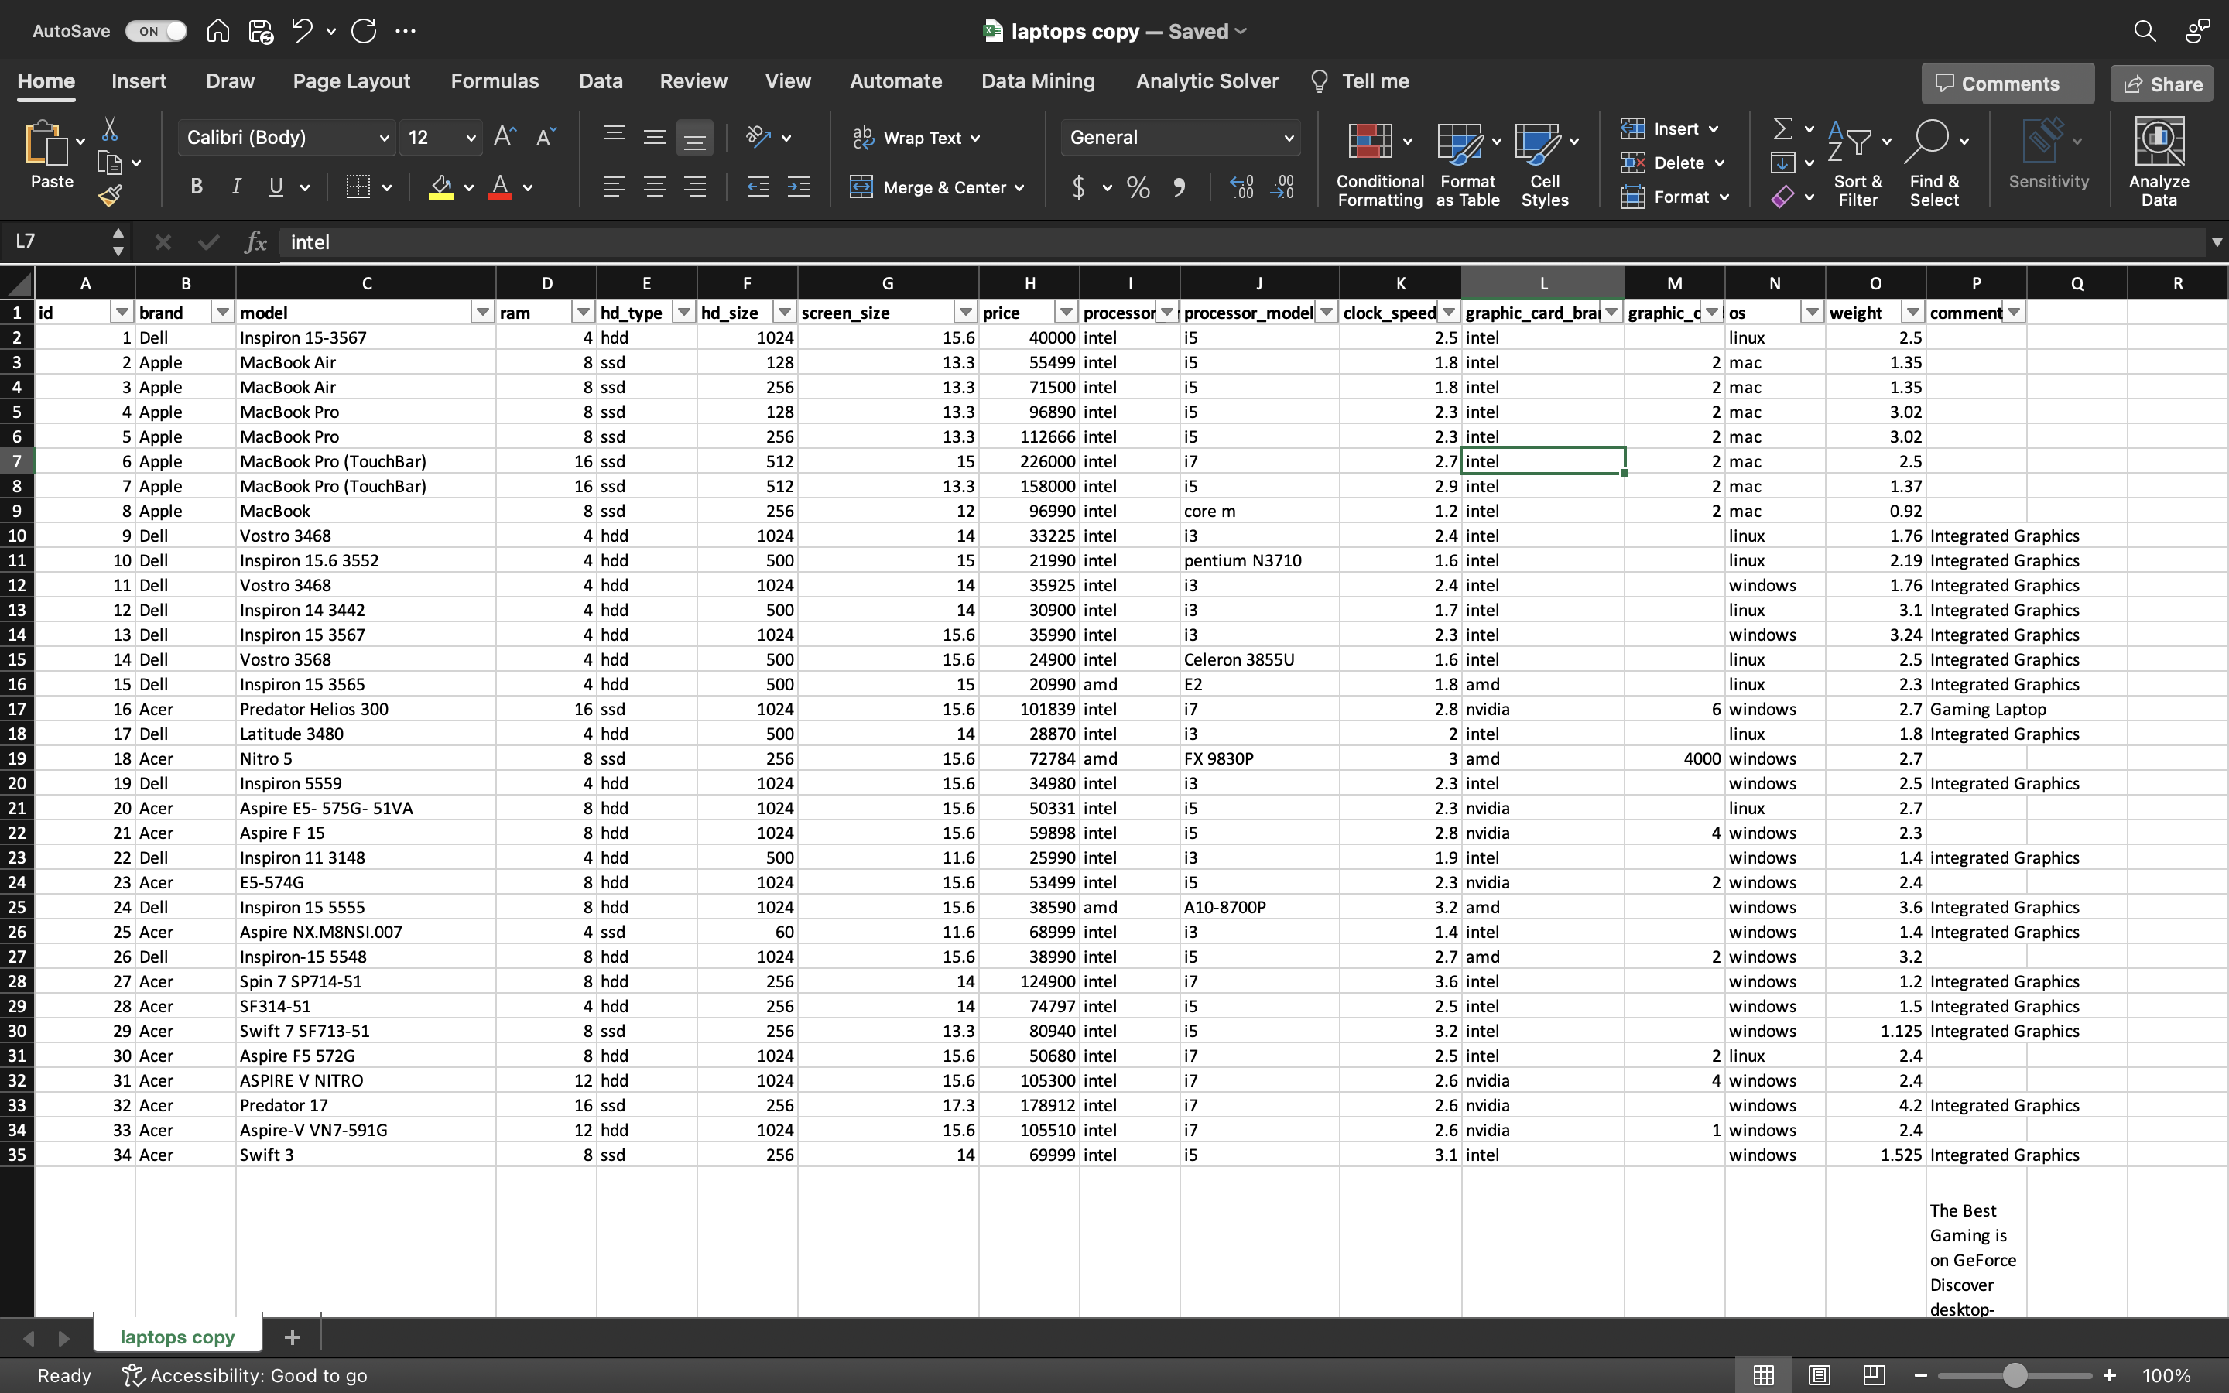
3. DataSet

Slide 6
4. Programming Language
Python - Programming Language
SPARQL - Query Language
RDFlib - Python library for working
with RDF data
Tkinter - Python library for creating
simple GUI for selecting and viewing user
profiles and recommendations

Slide 7
5. Lesson learned
Semantic Web Technologies
Personalization with SPARQL Queries
Dynamic Recommendation Generation
User-Centric Design
Semantic Reasoning

Slide 8
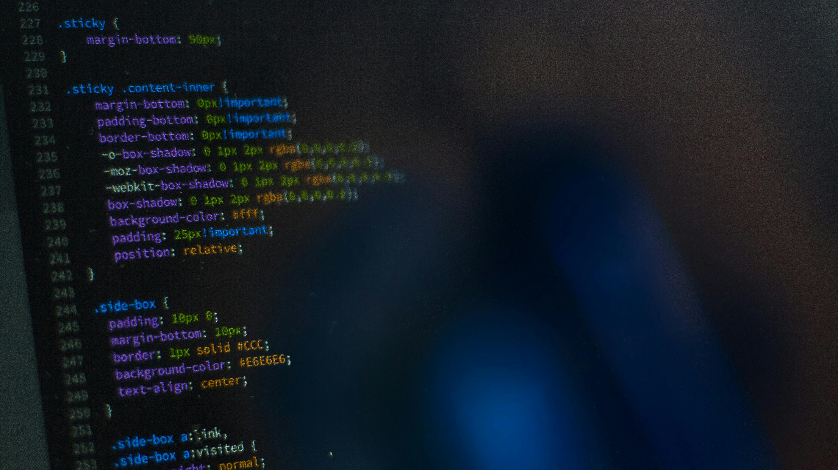
CODE DEMO

Slide 9
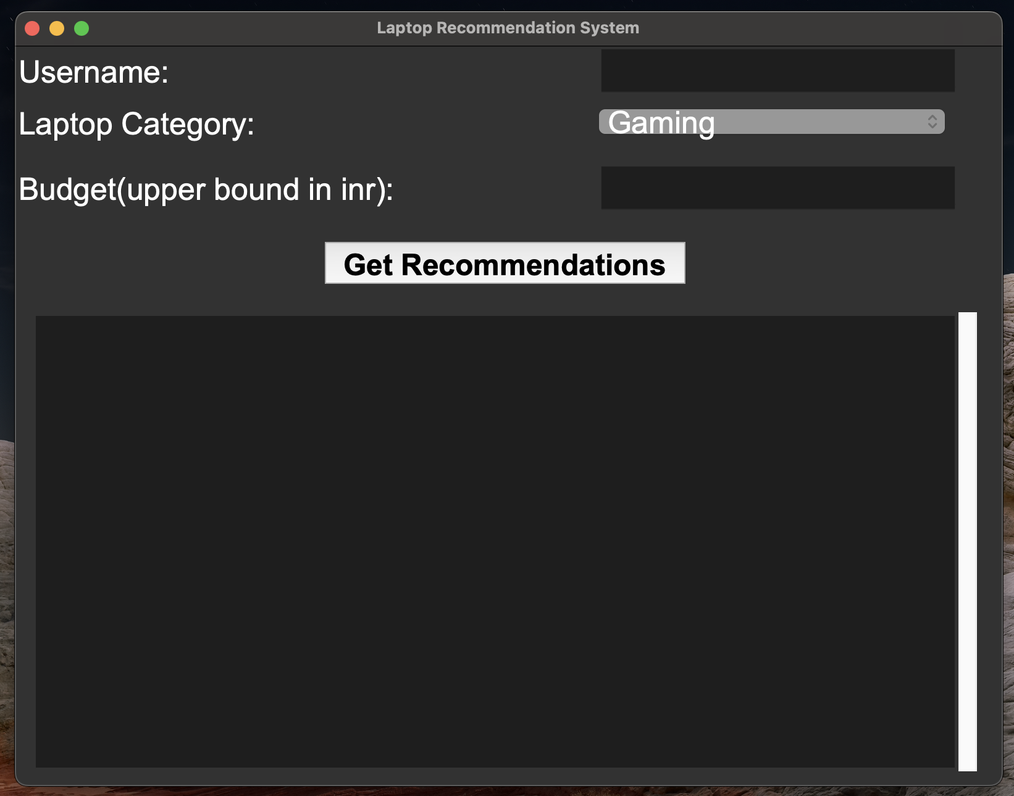
1. user interface

Slide 10
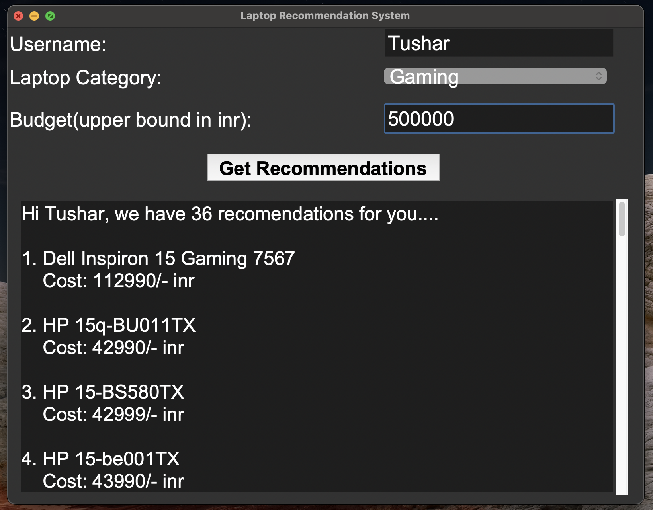
2. Gaming laptop recommendation

Slide 11
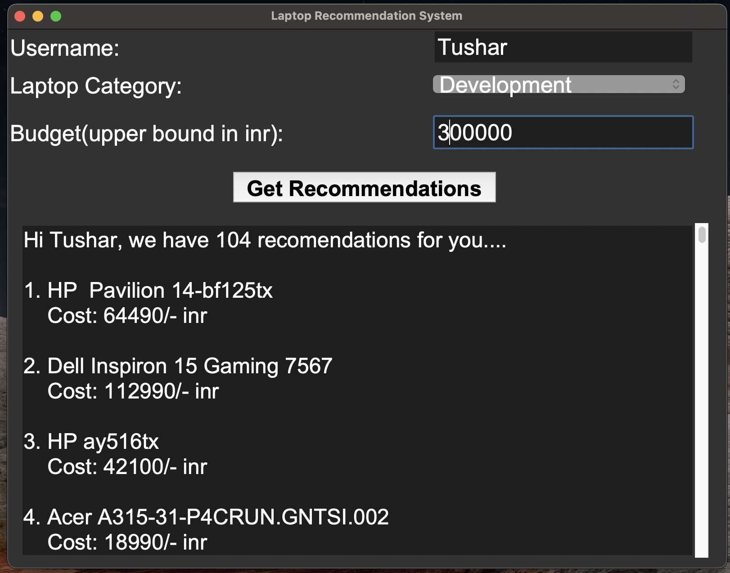
3. development laptop recommendation

Slide 12
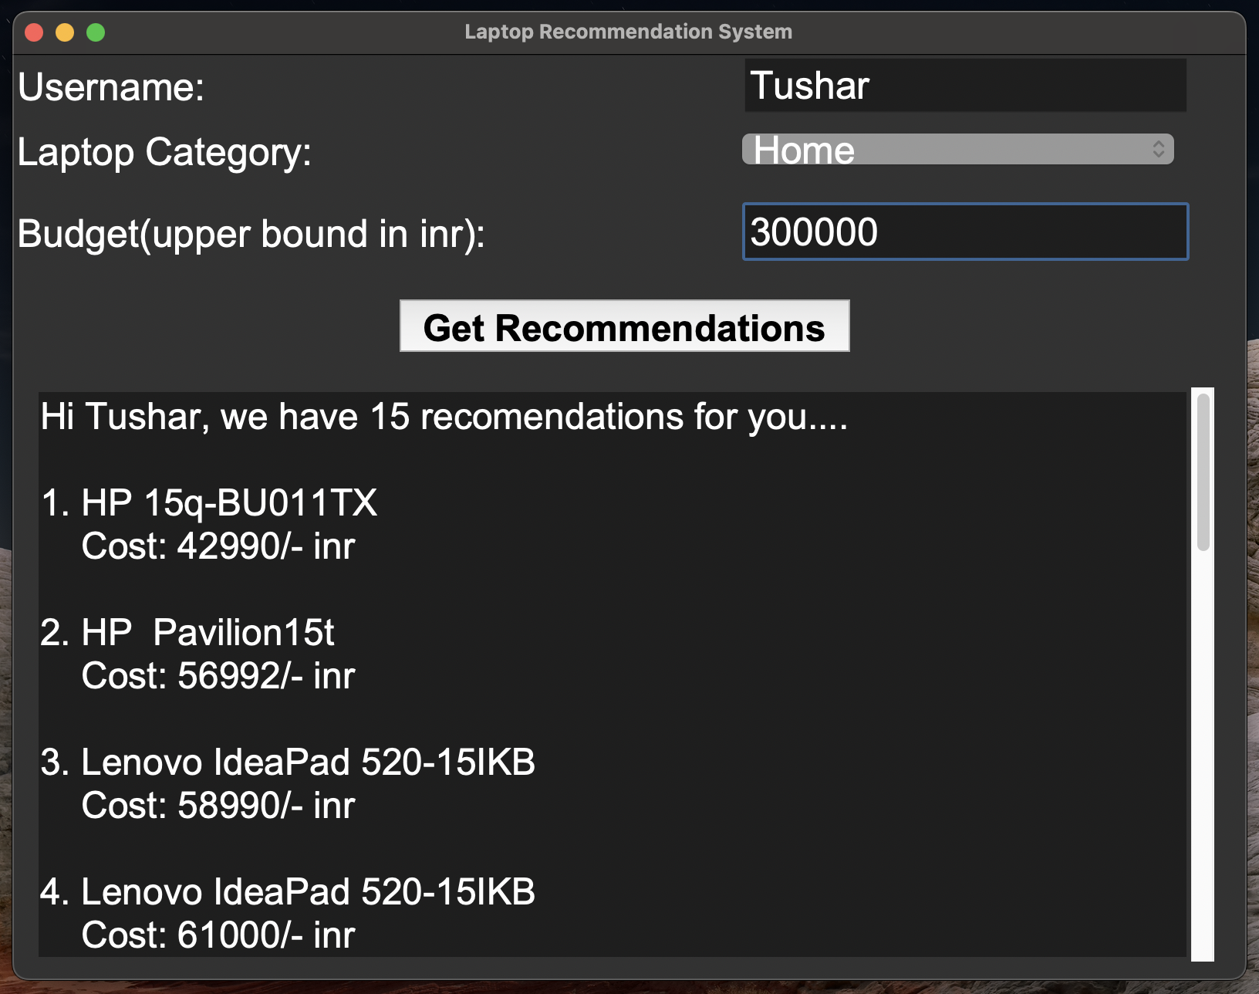
4. home laptop recommendation

Slide 13
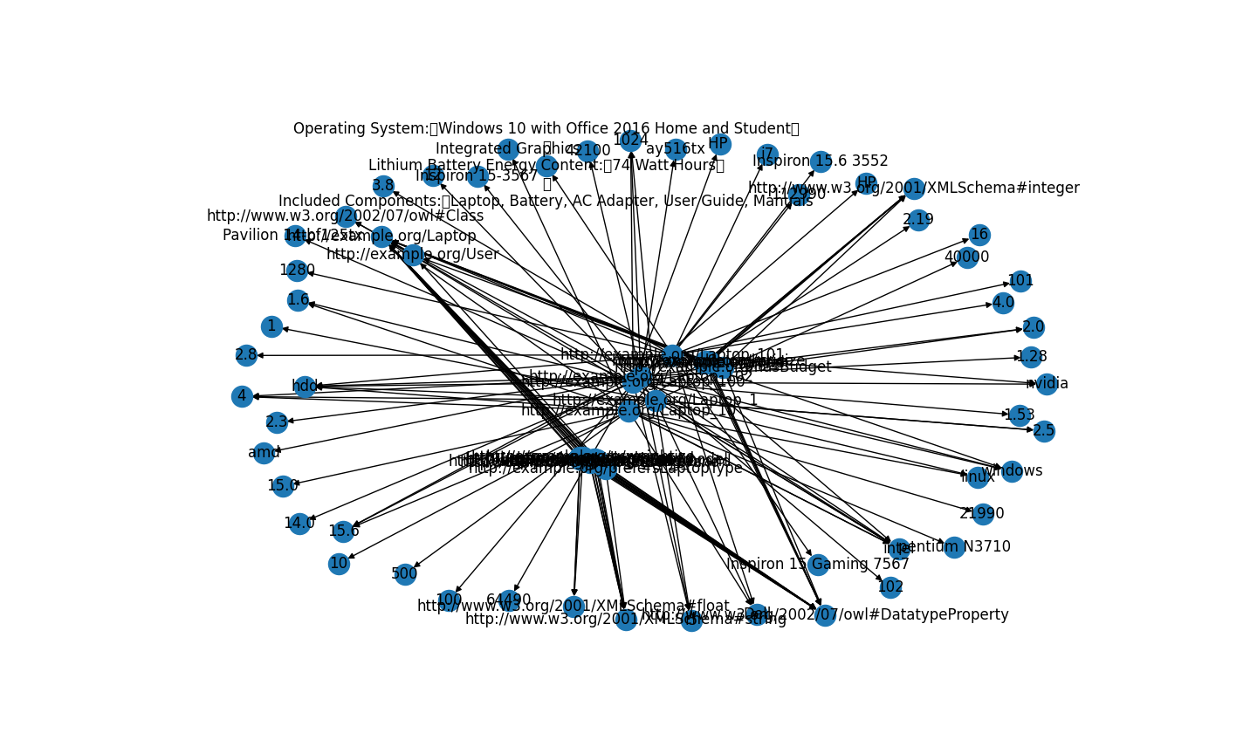
5.Graph visualisation

Slide 14
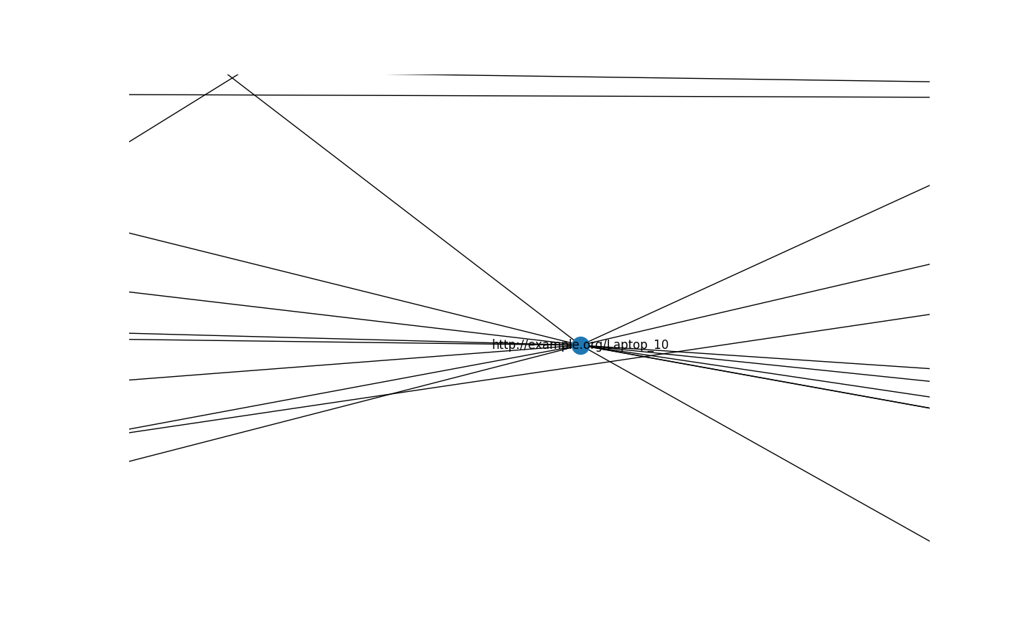
6. single node visualization

Slide 15
THANK YOU
We are open for Q & A :)

